Slide 1
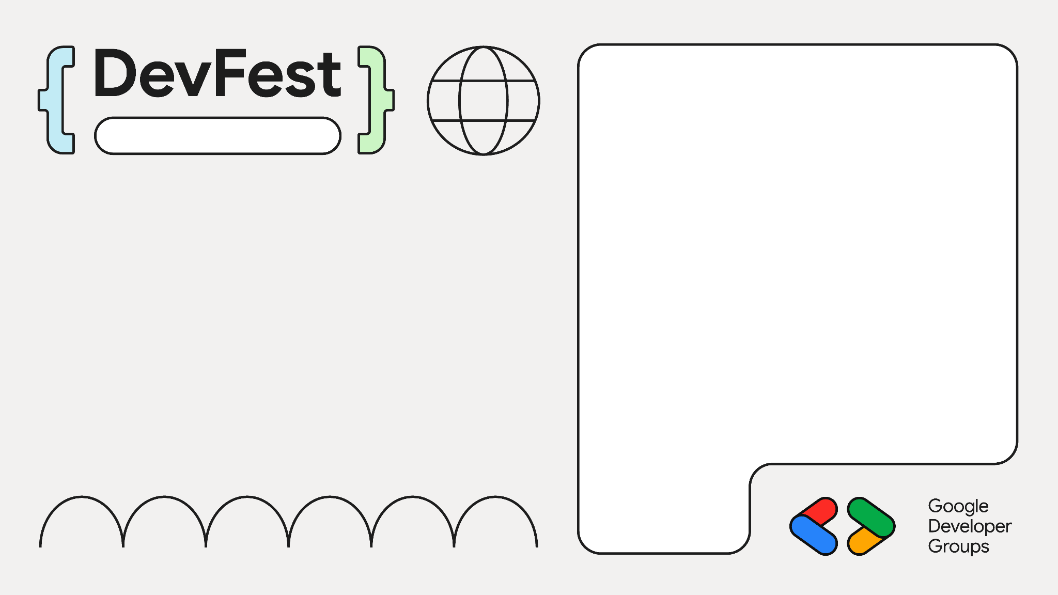
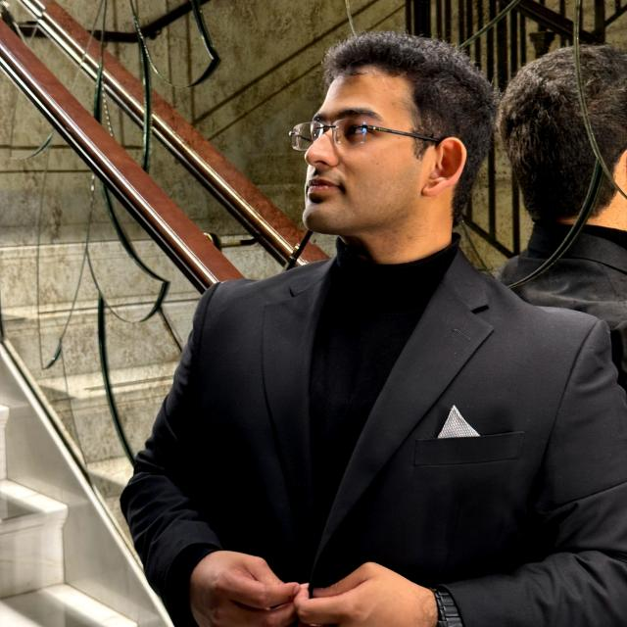
Build Your Own ChatBot With The RAG Architecture
Dubai
Rohan Mitra
ML Engineer @ Bayut | Dubizzle
Research Assistant for ML @ AUS

Slide 2
What is RAG Architecture?
Retrieval – Augmented Generation
Retriever: Finds and retrieves the most relevant documents or knowledge from a corpus
Generator (LLM): Uses the retrieved information as context to generate accurate, fact-based responses.
Answer questions more reliably and with additional info

Slide 3
The Need For RAG
LLM limitations
Knowledge cutoff and static information
Hallucinations
Memory constraints
Lack of domain specific knowledge
RAG Provides
Real-time information
Grounding responses
Domain expertise
Combines the fluent conversation abilities of LLMs with real-time factual accuracy

Slide 4
Case Study
You work for G-Electronics – an electronics seller
Sells TVs, Phones, Home Applicances, etc
You have been tasked with building a chatbot for customers to get suggestions on your products, and identify which products they want
You’re going to do this with a RAG Architecture

Slide 5
RAG Pipeline
User Question
Document Fetcher
Prompt Creator
LLM Model
Stream To User

Slide 6
User Question
User Question
User sends a question to the ChatBot
App has some preprocessing and moderation to question
Send response immediately incase of moderation
G-Electronics: “I want a smart TV 70 inch Samsung with Android OS. Show me cheapest options”

Slide 7
RAG Pipeline
User Question
Document Fetcher
Prompt Creator
LLM Model
Stream To User

Slide 8
Document Fetcher
Document Fetcher
Identify documents with possibly relevant info
Create VectorDB
Chunk documents, embed the text, and store meta-data to allow filtering
Group similar documents into indicies or partitions
Eg: Elastic Search, Pinecone, Marqo, Qdrant
Query DB using user intent (embedding) + filters
Retrieval models/engines
FAISS, Lucene, Dense Passage Retrieval

Slide 9
Document Fetcher
Document Fetcher: G-Electronics
Store each item’s listing in a database / index
Can have different indices for different types of products
TV, Mobile phone, Home appliances, latest products, can all have their own indices
Each item’s description is embedded using a sentence encoder and the output vector is stored
Meta-data about each item (size, price, color, brand, etc) are stored with the item’s listing for filtering

Slide 10
Document Fetcher
Document Fetcher
“I want a smart TV 70-inch Samsung with Android OS. Show me cheapest options”
TVs index
TVs index
TVs index
Latest_products index
Filters Applied:
Brand=Samsung
Size = 70
Sort = price ASC
Vector Similarity Search: ON
Documents Fetched: 5
Filters Applied:
Brand=Samsung
Size = 70
Sort = price ASC
Vector Similarity Search: OFF
Documents Fetched: 2
Filters Applied:
Size = 70
Vector Similarity Search: ON
Documents Fetched: 1
Filters Applied:
Brand=Samsung
Vertical = TV
Vector Similarity Search: ON
Documents Fetched: 2

Slide 11
RAG Pipeline
User Question
Document Fetcher
Prompt Creator
LLM Model
Stream To User

Slide 12
Prompt Creator
Prompt Creator
Use the fetched documents to create a prompt dynamically
The prompt will be sent directly to the LLM for generation
Possible prompt template:
Objective of the LLM
Background about information source
Sections for different types of information given to the LLM
User question and any additional instructions

Slide 13
Prompt Creator
Prompt Creator: G-Electronics
You are G-Electronics GPT. You answer questions about electronics and recommend electronics from our stores to the user. You will also give expert advise on anything about electronics….
We sell TVs, Mobile phones, and home appliances such as refrigerators and microwaves….
Here are the products we sell that may be relevant to the user:
…..
Here are the latest products by the brand requested by the user:
….
Here is the user’s intent identified: …..

Slide 14
RAG Pipeline
User Question
Document Fetcher
Prompt Creator
LLM Model
Stream To User

Slide 15
LLM Model
LLM Model
Send the prompt to the LLM model along with message history
Use frameworks like LangChain, LLamaIndex, etc
Send request to LLM (GPT 4o, local hosted LLM, etc)

Slide 16
RAG Pipeline
User Question
Document Fetcher
Prompt Creator
LLM Model
Stream To User

Slide 17
Stream To User
Stream Response
Set up streaming response (FastAPI has StreamingReponse class)
Intercept each chunk of text output by LLM for moderation
Log interactions to cloud – Prepare object to be logged

Slide 18



Dubai
Thank You!
https://www.linkedin.com/in/rohan-mitra14/
https://github.com/ro1406
scholar.google.com/citations?user=Jh0DuX4AAAAJ

